Slide 1
Office 365 Development

Slide 2
Introducing Visual Studio Napa for Office Developers

Slide 3

Agenda
Intro to Napa
Napa Compared to Visual Studio
Creating Office & SharePoint Add-ins

Slide 4















Vision
EXTEND OFFICE EVERYWHERE
CONNECT TO OFFICE 365 SERVICES
BUILD USING AN OPEN PLATFORM
Delve
z
Users and groups
Files
Mail
Calendar
My Apps
Video Portal
Contacts
Office Graph
Presentations
Documents
Spreadsheets
Lync
OneNote
Yammer

Slide 5
Intro Napa

Slide 6
What is Napa?
Web-based code editing tool for client-side Add-ins for Office clients & SharePoint
Similar code existing experience to Visual Studio
Code syntax highlighting
IntelliSense
No installation required, entirely web-based
Hosted by Microsoft
No license required; entirely free!
Notes:
Napa is a web-based code editing tool for development of client-side add-ins developed for Office clients or SharePoint. The code editor is the same editor used by Visual Studio Online (aka: Monaco). It facilitates a similar coding experience to Visual Studio in the sense of color syntax highlighting & IntelliSense.
However it is limited to client-side development; this means you are limited to working with sites based on HTML, CSS & JavaScript, but that’s includes a ton of solutions. If you need to add server-side code to your project, you can always open the Add-in project in a locally installed Visual Studio instance straight from Napa!
But Napa requires no local install. You can create Add-ins with only an interet connection, supported browser & a login… either a Microsoft Account or Office 365 login.

Slide 7
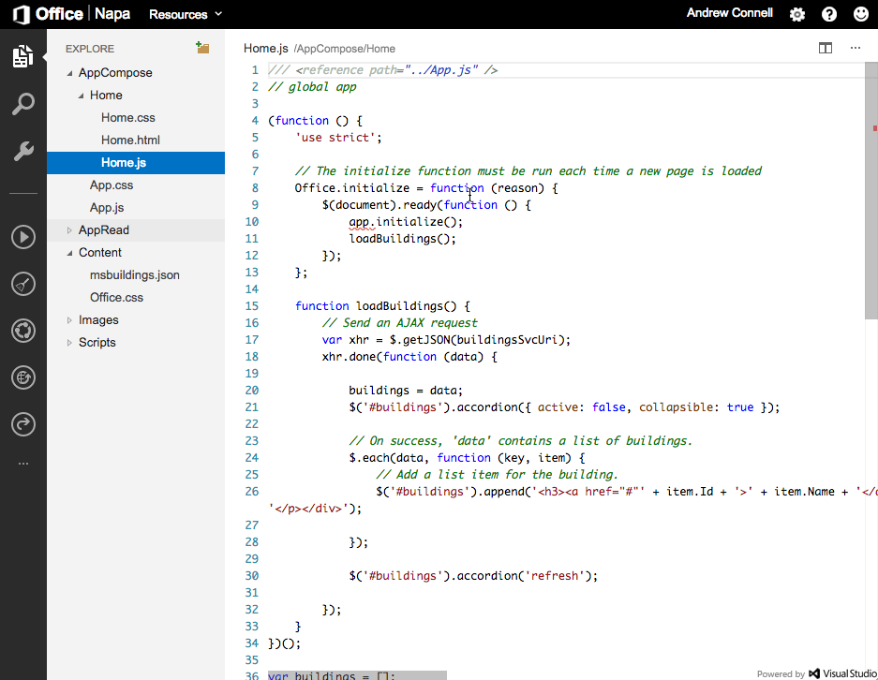

Slide 8
What Can You Do With Napa?
Create client-side web applications for Add-ins
Deploy & test an Add-in straight from Napa
Publish Add-ins to App Catalogs or Office Store
Share Add-ins with peers for collaborative development
Notes:
What can you do with Napa?
(1) Create client-side web applications for Add-ins for both Office clients & SharePoint.
(2) Deploy & test an Add-in straight from Napa
(3) Publish Add-ins to App Catalogs or Office Store
(4) Share Add-ins with peers for collaborative development

Slide 9
What Can You Build with Napa?
SharePoint Hosted Add-ins
Office Add-ins
Task Pane Add-ins
Content Add-ins
Mail Add-ins
Notes:
What can you build with Napa? It boils down to two types of things: Office Add-ins & SharePoint Add-ins. Later in the slides we will cover the different flows you can leverage to deploy Add-ins.

Slide 10
Accessing Napa
https://www.NapaCloudApp.com
Login using your Microsoft Account
Enables creating Office Add-ins
Deploy & debug against Office Web Clients in OneDrive
Notes:
There are two ways two access and use Napa. The first way is with your Microsoft Account, also known as MSA and formerly known as your Live ID. This option allows you to create Office Add-ins that you can test using the Office Web Clients from your OneDrive Consumer accounts.

Slide 11
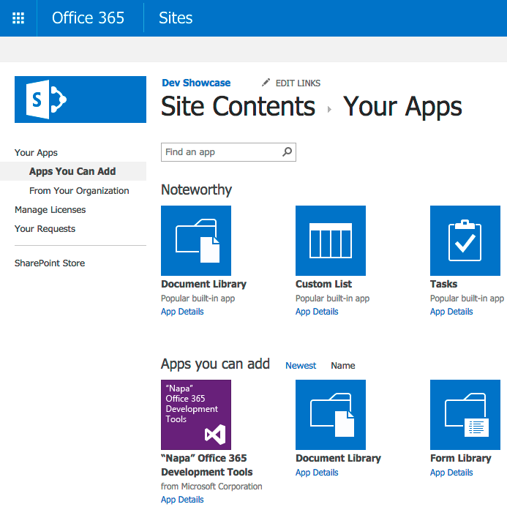
Accessing Napa – Office 365
Add the Napa app to your SharePoint site
Available in the SharePoint Store
Launch Napa to author add-ins
Notes:
The other way of using Napa is to install the Napa App as an Add-in from the SharePoint Store in your Office 365 / SharePoint Online site. When you do this, you can use Napa to create both SharePoint Add-ins and Office Add-ins. The SharePoint Add-ins are SharePoint Hosted Add-ins, not Cloud Hosted, due to the fact you can’t author server-side code in Napa

Slide 12
demo
Create Office and SharePoint Add-ins with Napa

Slide 13
Napa Compared to Visual Studio

Slide 14
How Does Napa Compare to Other Tools?
Visual Studio
Visual Studio Code
Napa
Notes:
You might be asking “wait, now there are three tool offerings from Microsoft… Visual Studio, Visual Studio Code and now Napa… what should I use?”
Let’s look at each of these …

Slide 15
Visual Studio
Microsoft’s primary IDE for professional developers
Provides the richest & most comprehensive developer experience for SharePoint & Office Add-in development
Create client-side & server-size web projects
Includes productivity boosting wizards & designers
Rich debugging
Must be installed on Windows
Notes:
Let’s first start with the one that most people are familiar with Visual Studio because for so many years that’s been Microsoft’s only developer environment for professional developers. Visual Studio is a full integrated development environment (IDE) filled with designers, wizards & dialogs to help professional developers be more productive. It includes the richest development tools that Microsoft has to offer.

Slide 16
Visual Studio Code
Microsoft’s code editor for web developers
Includes rich IntelliSense
Facilitates cross platform debugging
Code editor – no designers or wizards
Must be installed
Available on Windows, OSX & Linux
Notes:
In April 2015 Microsoft released a new code editor called Visual Studio Code. This includes the web-based Visual Studio editor that you find in Visual Studio Online, also called Monaco. The target audience is web developers… it’s a code only view… you won’t find any designers, dialogs or wizards. It does require a local install but it’s cross-platform in that you can install it on Windows, OSX or Linux.
Like Visual Studio it supports client-side & server-side development… for instance you can do Node.js development or ASP.NET v5 development with Visual Studio Code.

Slide 17
Napa
Web-based code editor for web projects
Ideal for client-side web applications
Enables rapid Add-in creation by power users, web developers or professional developers
Uses same code editor in Visual Studio Code
Only requirements:
No installation required!
Internet connection
Supported Browser
Office 365 / MSA login
Notes:
Where does Napa fit into this developer tooling story?
Similar to Visual Studio Code, it hosts the Monaco web-based / hosted code editor and intended primarily for web projects. It does support doing client-side development but unlike the other tools, you cannot do server-side development.
Who is this targeted for? It’s really a long list… professional developers can use it to create Add-ins for SharePoint or Office clients as it really simplifies a lot of the steps required to creating, deploying and debugging a project. However it’s also a great tool for power users who are savvy with HTML, CSS & JavaScript.
Plus, the only thing you need to use Napa is a internet connection, a supported browser and either a MSA or Office 365 account. You can even build add-ins using a tablet that isn’t running Windows!

Slide 18
Creating Office & SharePoint Add-ins

Slide 19
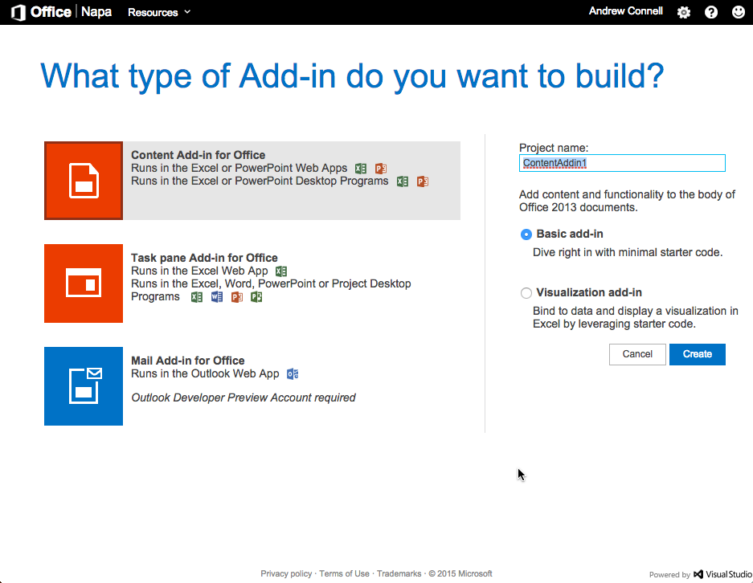
Signing in with Microsoft Accounts
Login to NapaCloudApp.com with a Microsoft Account
Office 365 not required
Create Office Add-ins for the Office Web Apps from OneDrive Consumer
Notes:
When you login to the Napa app using your MSA, you can only create Office Add-ins; you cannot create SharePoint Add-ins.

Slide 20
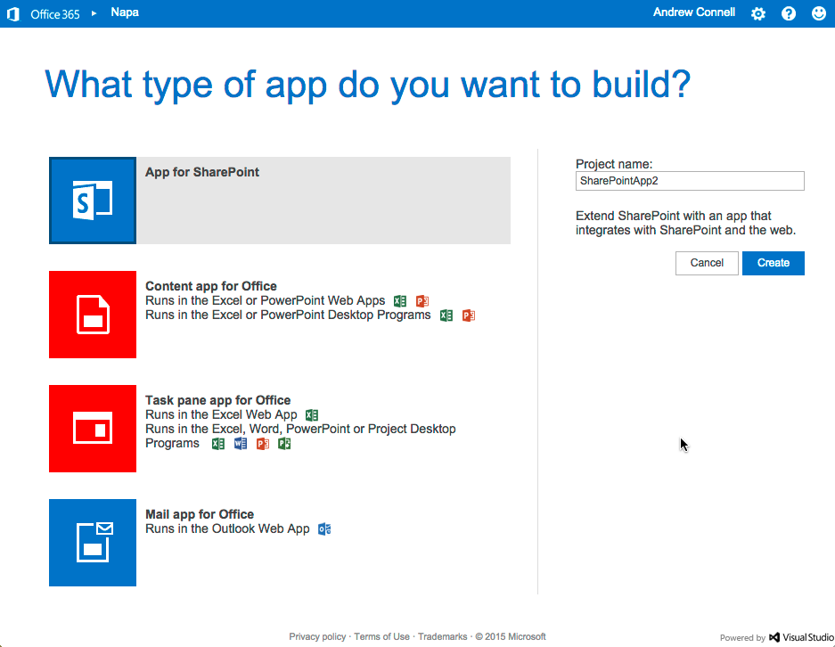
Signing in with Office 365
Add the Napa Add-in from the SharePoint Store
Create Add-ins for
Office Client Apps
SharePoint
Notes:
However When you login to the Napa app using Office 365, you can create Office Add-ins and SharePoint Add-ins.

Slide 21
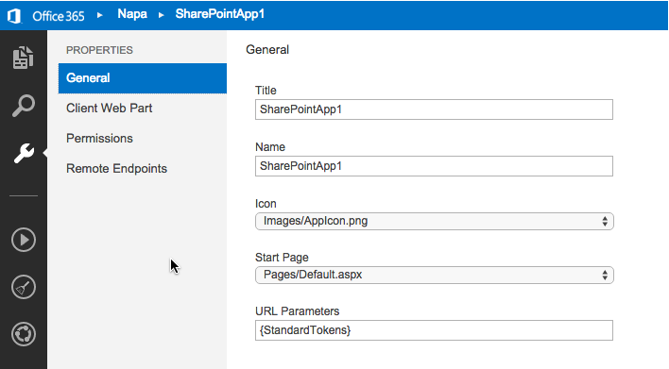
Edit SharePoint Add-in Manifest
Notes:
Napa it’s just for updating the code… you can also modify the SharePoint Add-in manifest to define things like permissions & metadata about the application.

Slide 22
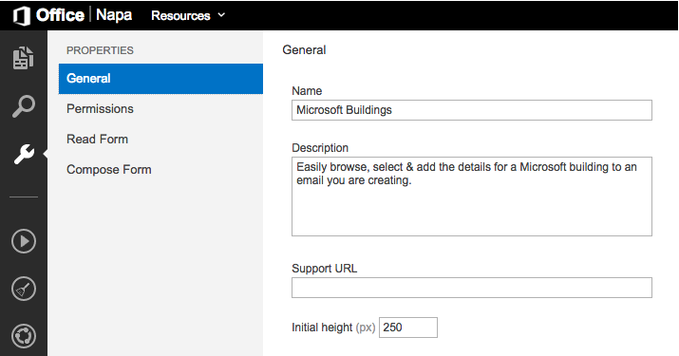
Edit Office Add-in Manifest
Notes:
Napa can also modify the Office Add-in manifest to define things like permissions & metadata about the Add-in. In the screenshot here, you are looking at a Mai Add-in for Outlook. If you are working on a task pane or content add-in, you won’t have options for a Read Form or Compose Form.

Slide 23
demo
Create Microsoft Buildings Email Compose Outlook Add-in

Slide 24
Summary
Intro to Napa
Napa Compared to Visual Studio
Creating Office & SharePoint Add-ins

Slide 25


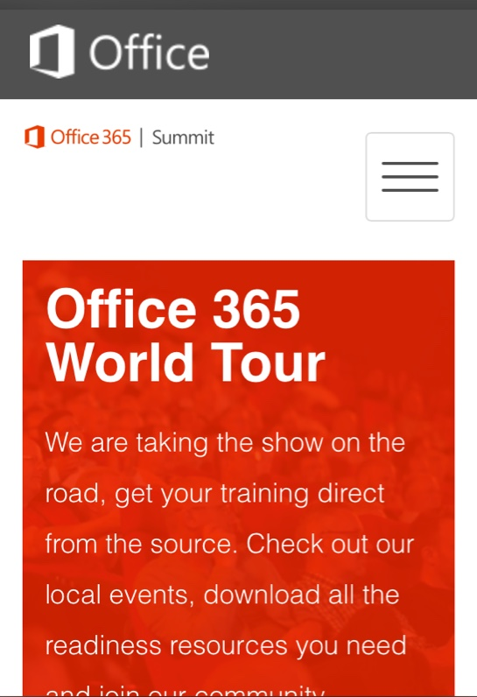
dev.office.com
Sign up
http://dev.office.com/getting-started
Explore
http://apisandbox.msdn.microsoft.com
Get trained http://dev.office.com/training

Slide 26


Feedback
Office 365 Network Share you best practices and join conversations https://www.yammer.com/itpronetwork
Stackoverflow Ask deep technical questions to a world-wide set of developers
http://stackoverflow.com/questions/tagged/ms-office
UserVoice Provide suggestions of what you want in future versions
http://officespdev.uservoice.com/

Slide 27

© 2012 Microsoft Corporation. All rights reserved. Microsoft, Windows, and other product names are or may be registered trademarks and/or trademarks in the U.S. and/or other countries.
The information herein is for informational purposes only and represents the current view of Microsoft Corporation as of the date of this presentation. Because Microsoft must respond to changing market conditions, it should not be interpreted to be a commitment on the part of Microsoft, and Microsoft cannot guarantee the accuracy of any information provided after the date of this presentation. MICROSOFT MAKES NO WARRANTIES, EXPRESS, IMPLIED OR STATUTORY, AS TO THE INFORMATION IN THIS PRESENTATION.

